Slide 1
OCCUPATIONAL TELEMEDICNE
MIDSOUTH WORKERS’ COMPENSATION MEETING
FEBRUARY 15,2019
DAVID K. TUTOR, MD,
PRESIDENT/MEDICAL DIRECTOR TAP TO TREAT OCCUPATIONAL TELEMEDICINE

Slide 2
Agenda
Tap To Treat Video
Questions/Prize Guidelines
Telemedicine Presentation
Interactive Discussion/Questions
Live “Virtual” Demonstrations
Grand Prize Drawing

Slide 3
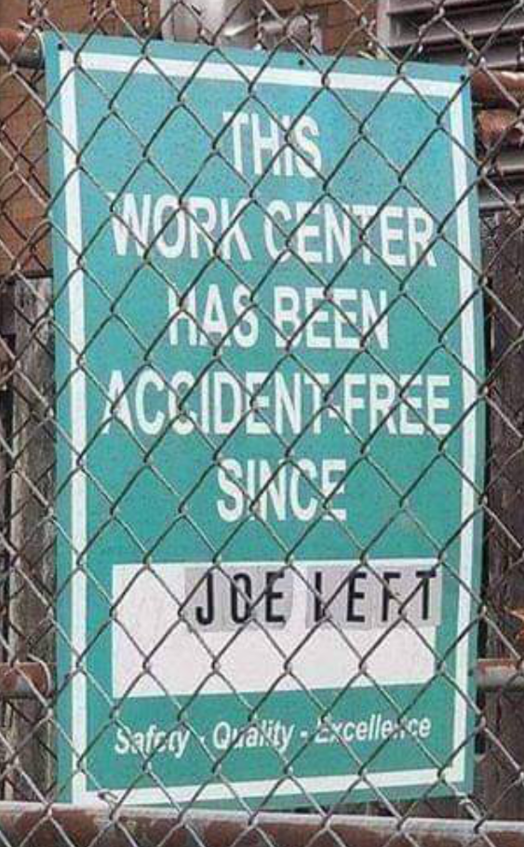

Slide 4
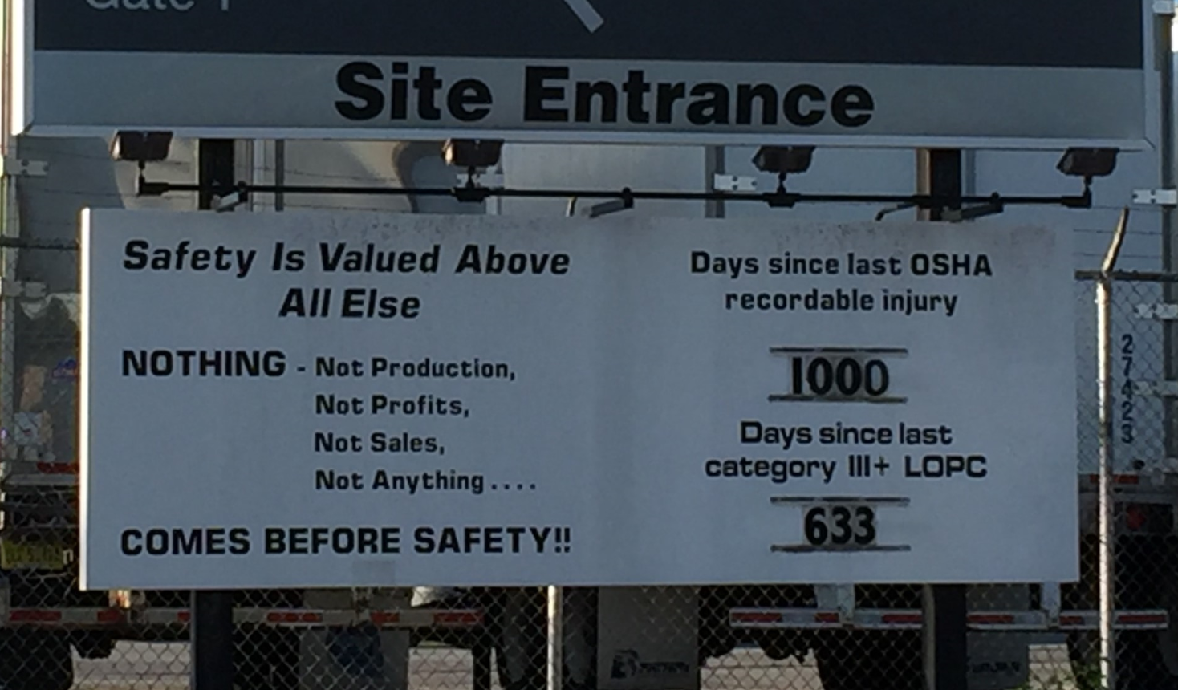

Slide 5
Telemedicine from a provider’s perspective
As a provider, my greatest benefit is what i can offer to my industrial partners and their employees:
24/7/365 virtual clinic on their site complete with rns, apns, mds
Immediate availability when injury occurs
Offered for a fraction of the cost of a brick and mortar onsite clinic

Slide 6
TELEMEDICINE
How to be there – anytime, anywhere for injured workers and employers with provider access 24/7
What’s needed:
Device
Internet connection
Private area
What you get:
Virtual, video/audio, face to face healthcare visit

Slide 7
PRIZE QUESTION
NAME A DEVICE THAT CAN BE USED IN TELEMEDICINE.

Slide 8
THE NURSE WILL SEE YOU NOW…
The RN meets the patient in the virtual waiting room, performs triage, and directs the treatment path forward per appropriate protocol:
No treatment
Simple conservative first aid treatment and follow up with the rn
Referral to a virtual tap to treat advanced practitioner and/or md for treatment and follow up
Referral to a brick and mortar medical clinic
Referral to the emergency department

Slide 9
WHAT’S APPROPRIATE FOR VIRTUAL TREATMENT?
COMMON WORK-RELATED ISSUES THAT CAN BE TREATED VIRTUALLY:
ABRASIONS/MINOR SKIN WOUNDS
CONTUSIONS
STRAINS/SPRAINS
INFECTIONS
MINOR HEAT/COLD/CHEMICAL EXPOSURES
MINOR BURNS
INSECT BITES
DERMATITIS/OTHER RASHES
MINOR EYE IRRITATION
MINOR RESPIRATORY IRRITATION
MINOR EAR IRRITATION (E.G. FROM EAR PLUGS)
MINOR NERVE IRRITATIONS/EXTREMITY NUMBNESS OR TINGLING
THIS LIST IS NOT COMPREHENSIVE – MANY MORE COMPLAINTS CAN BE TREATED VIRTUALLY.

Slide 10
As a Telemedicine Provider
My purpose is to provide VIRTUAL MANAGEMENT of work related conditions from injury to MMI
Two criteria must be met for the ATP to be virtual:
1. The medical condition must be appropriate for virtual management
2. Virtual management must meet the expectations of the injured employee
My goal is to achieve an excellent outcome for the injured employee while meeting the employer’s expectations

Slide 11
What happens in the Emergency Department…
ED’s are necessary, but…
Injured employees too often receive “knee jerk” referrals to an ED for conditions that do not require that level of care
Unnecessary ED visits carry a high cost burden for Worker’s Compensation
24/7 Telemedicine virtual onsite clinic will most often eliminate the inappropriate ED referrals

Slide 12
By eliminating the ED visit, Telemedicine can help the employee and employer:
Save the ED charge
Avoid “obligatory” prescriptions
Avoid “obligatory” restricted days and lost time
Avoid potential for unnecessary testing and referrals
Avoid transportation issues
Avoid the inconvenience and lost productivity of waiting
Avoid exposures to infectious illness and other ED “situations”
Avoid communication gaps

Slide 13
What about the Walk In Clinic?
Most rural areas do not have occupational health clinics
Injured employees are commonly referred to Family Docs and Walk In Clinics in these areas
WC patients receive “primary care/urgent care” treatment when in fact they need to be treated differently—more aggressively—to achieve desired outcome
Result—higher cost, more medications, more restricted days and lost time plus higher OSHA recordability rates

Slide 14
PRIZE QUESTION
WHAT IS ONE OF THE MANY BENEFITS OF OCCUPATIONAL TELEMEDICINE?

Slide 15
The consistent Worker’s Compensation appropriate care management provided by a good Occupational Telemedicine Provider can help injured workers and employers avoid the risks associated with ED and Walk In Clinic Visits

Slide 16
Occupational Telemedicine benefits for the injured worker
Early intervention with immediate evaluation/treatment for their injury
Convenience—first visit “onsite”, follow up “wherever they’re comfortable”
Avoid travel, wait times and “the flu”
One point of contact—RN is with them from injury to MMI
Daily healthcare visits in the acute injury phase if appropriate
Avoid unnecessary testing, meds and referrals
Financial due to avoiding lost + remain engaged, satisfied and productive

Slide 17
Occupational Telemedicine benefits for the employer
Cost Savings—reduced ED visits, meds, referrals and lost time
Providers experienced in Workers’ Compensation
Reduced restricted days and lost time
Reduced OSHA recordability risk
Single point of contact from injury to MMI
Consistency of process and care across multiple sites
Injured employee remains engaged and productive at work
Convenience/Saves time
WC injury management protocols customizable to site specific needs
Communication capability through multiple platforms

Slide 18
The Future Appears Bright
Initial data analysis show that outcomes for work related injuries managed by telemedicine in a virtual onsite clinic are consistent with case outcomes managed in conventional onsite clinic.
Outcomes evaluated include case outcomes for the injured worker and the employer

Slide 19
Conclusion
Telemedicine can play a vital, stand alone role in the evaluation, treatment and management of injured workers.
Telemedicine can provide immediate, convenient alternative to brick and mortar clinics and emergency departments
Telemedicine provides COST SAVINGS, improves communication, reduces restricted days, lost time and osha recordability risk while providing consistency of process and care across multiple sites

Slide 20
Interactive Discussion! Questions? Live “Virtual” Demonstrations! Grand Prize Drawing

Slide 21
THANK YOU!
Tap To Treat
David K Tutor, MD
President/Medical Director
311 South Weisgarber Rd
Knoxville, TN 37919
drtutor@taptotreat.us

